Slide 1
Digit & Symbol Recognition
By Ben Hunt and Todd Tribble…. But mostly Ben

Slide 2
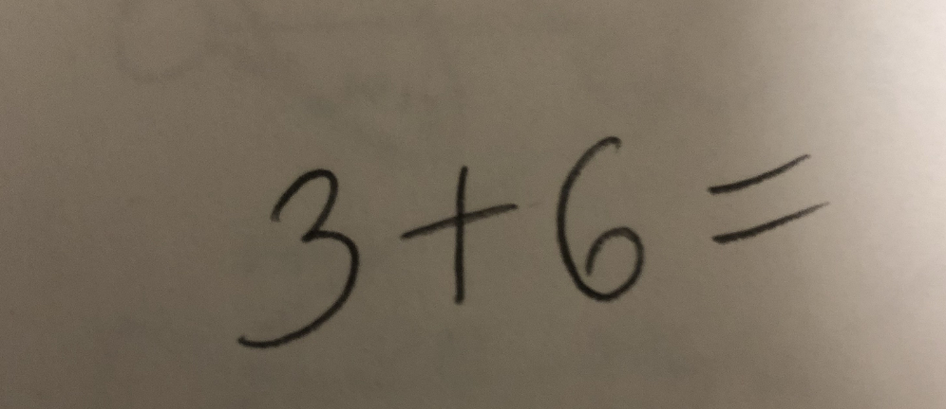
The Objective
Design a neural network that can perform hand written arithmetic
Input:
Output:
9

Slide 3

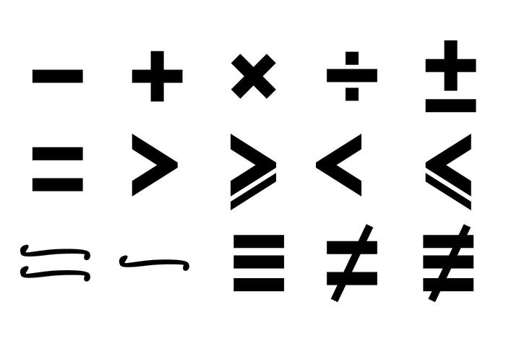



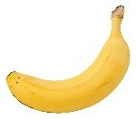


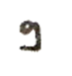
How
Gather a data set of hand-written digits and symbols to train on
Train a neural network to learn the “features” of these digits/symbols
Feed in new data to the network and make a prediction
= 2 = 5 =
= 2 = 5 = 9

Slide 4
The Data
Data set used :
MNIST including 60,000 training samples and 10,000 test samples of hand-written digits from 0-9
200 training samples and 40 testing samples of plus and minus signs we created ourselves with a Microsoft drawing tablet.
Format of data :
Each image contained 784 pixels, making a 28X28 square
Each pixel contains a value from 0-255, in grayscale, normalized to a 0-1 scale

Slide 5
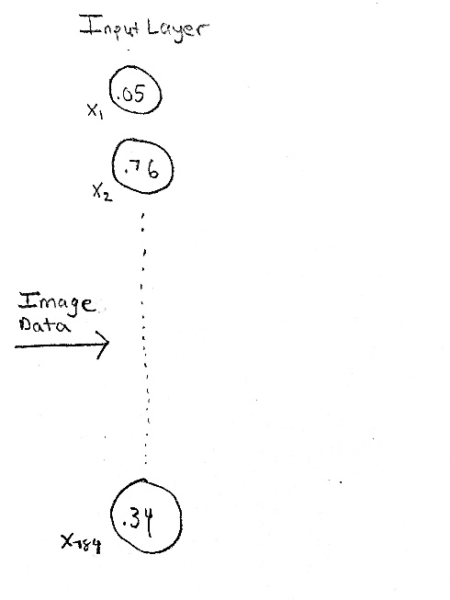
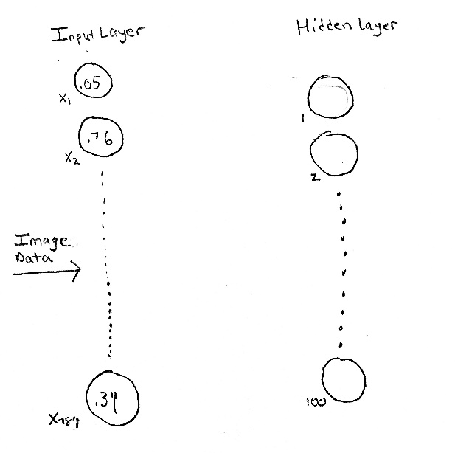
Creating the Network
Since our image is a 28X28 square, our network required 784 input nodes
Interesting fact : an actual neuron is 100,000 times smaller than an artificial one
Interesting side-note : I’m not sure if that’s true
We chose to have 1 hidden layer with 100 nodes to minimize runtime but still reliable results. No specific amount of hidden layer nodes is recommended.

Slide 6
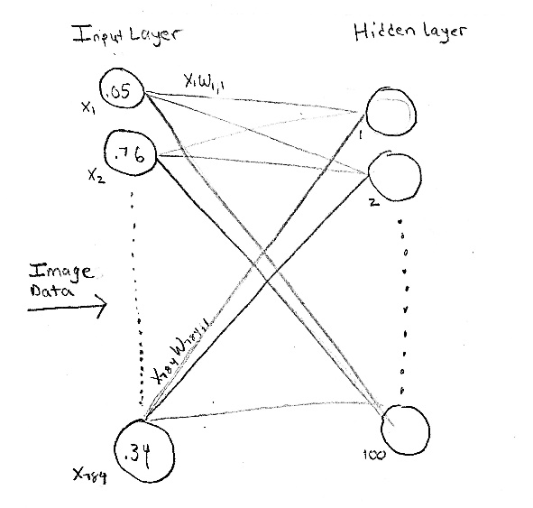
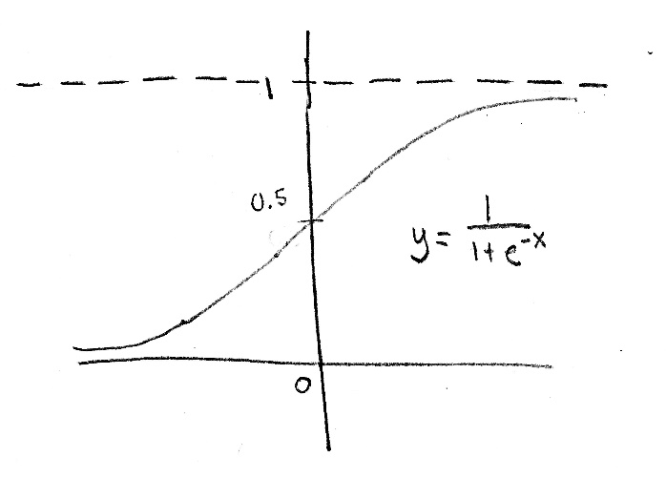
Creating the Network
Need links connecting the inputs from one layer to the nodes in the next.
These links are weighted. Some inputs should mean more to the output than others. Initialize weights using normal probability distribution with std. dev. related to the amount of links coming into the node.

Slide 7
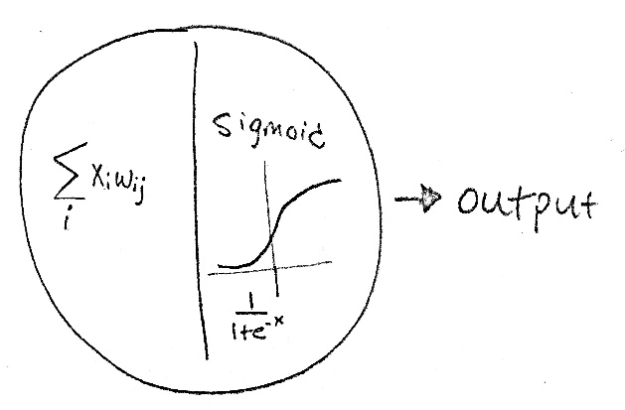

Creating the Network
Weighted Links are summed up and passed through an activation function in the neuron. We used the sigmoid function.
Output from this hidden layer node goes into the next node as input.

Slide 8
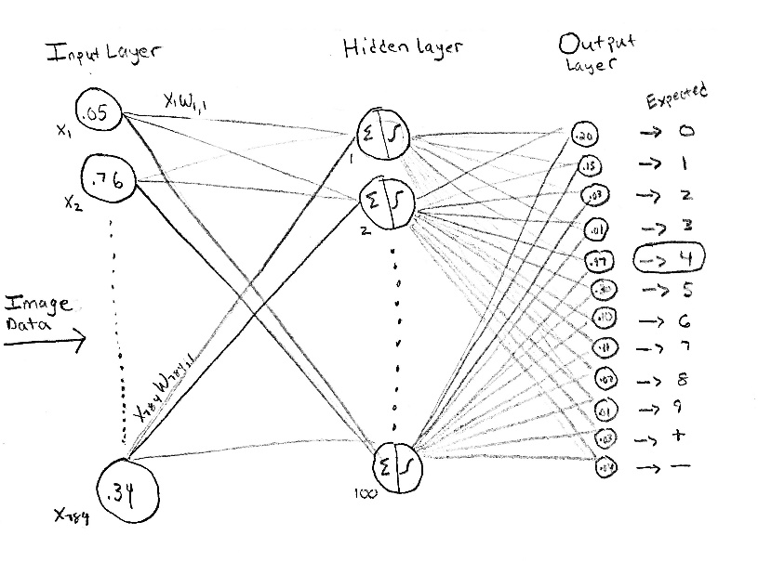
Creating the Network
Our final output layer consists of 12 nodes corresponding to digits 0-9 and math symbols (+) and (-)
Output with the highest value from 0.1 to 0.99 is the predicted value.

Slide 9
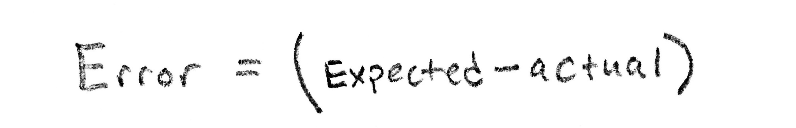
Training the Model
Now that we have an output, what do we do with it?
Find Error, use error to update the network.

Slide 10
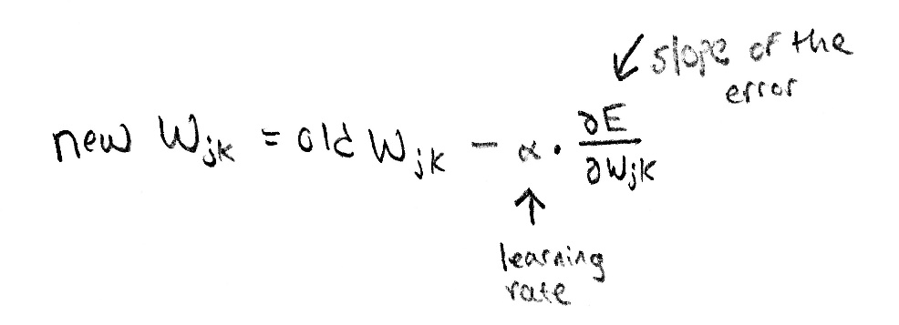
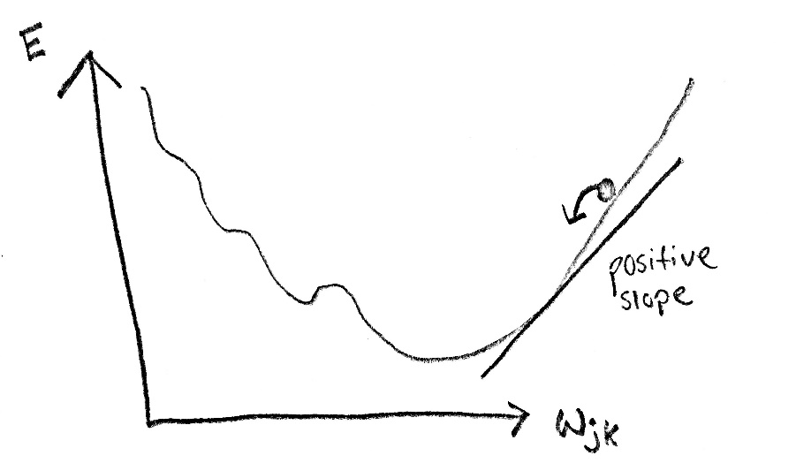
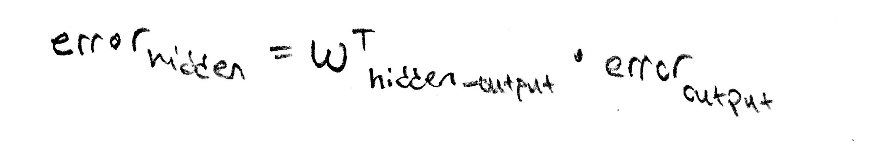
Training the network
Back propagate the error using gradient descent
Update calculate error on hidden layer node.

Slide 11
Train the Network, build the Model
Network is set up, feed in the data! Used Ipython 3.6 and the Anaconda development suite. We trained the neural network on a subset of 1000 of the 60,000 character set. We had ~ 100 (+) and (-) sign examples being trained as well.
Feed forward the network n times where n is the amount of training examples.

Slide 12
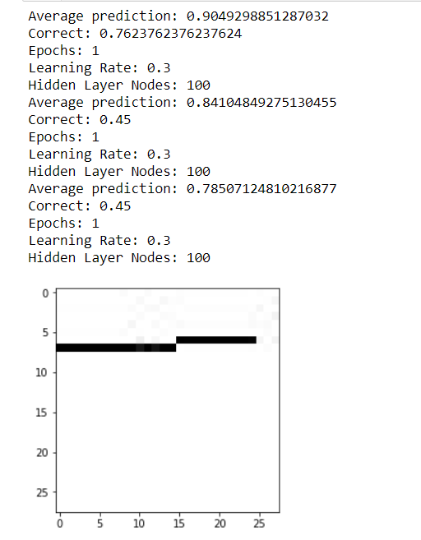
Test the Model
We tested the model on a set of 100 digits
and 40 (+) (-) symbols
Worked really well on digits. Noise in our own dataset.
Mixed results.
Tried our own hand writing? – yes but no.

Slide 13
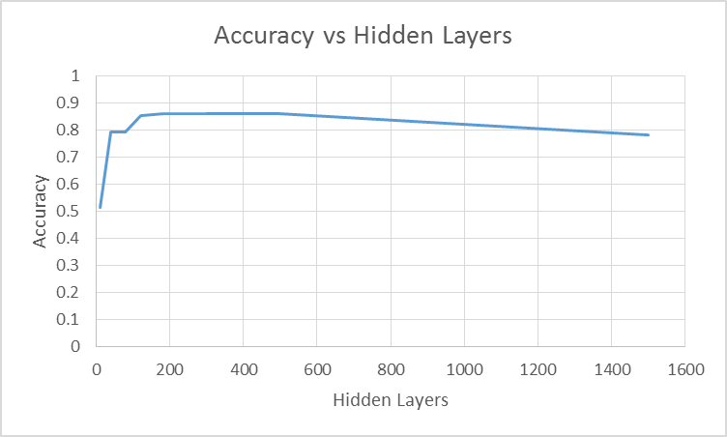
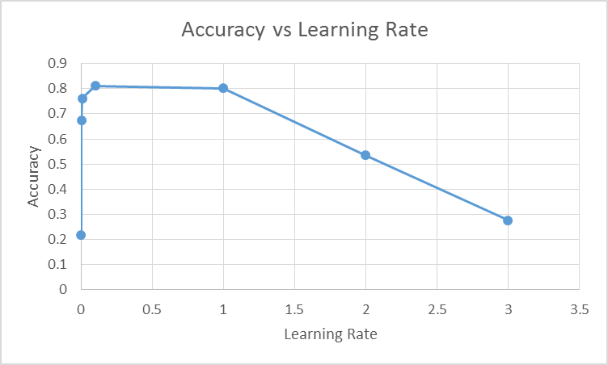
Results
Two few, it restricts the ability to find features
Never converges

Slide 14
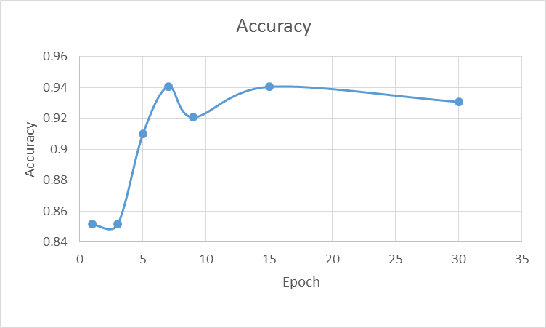
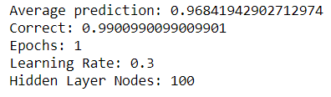
Results
It’s over .9000!

Slide 15
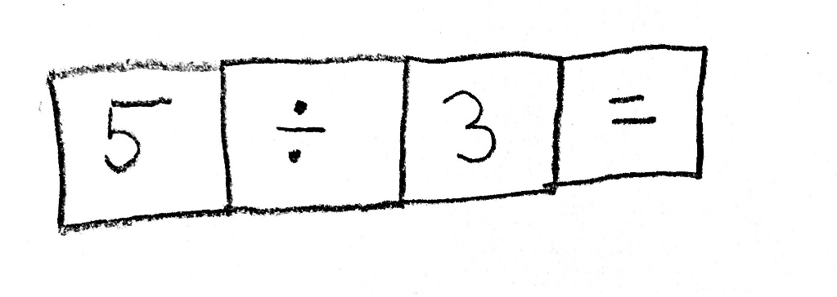

Future Development
You might ask, Professor.. How do I predict Banana?

